Slide 1
Cyclist bike share analysis
Pranav Shintre
DM15-16

Slide 2
AGENDA
Business Task
Data Cleaning & Manipulation
​Summary of Analysis
Visuals
​

Slide 3
Business task
Cyclistic’s historical trip data to analyze and identify trends. The director of marketing believes the company’s future success depends on maximizing the number of annual memberships. Therefore, your team wants to understand how casual riders and annual members use Cyclistic bikes differently. From these insights, your team will design a new marketing strategy to convert casual riders into annual members.

Slide 4
Data cleaning & Manipulation

Slide 5
Data Cleaning & Manipulation
Before importing the data into Power Bi, some basic data type correction were made to started_at & ended_at columns where the date & time were demlimited for better understanding of the data.
Time & Date were delimited into different columns and then end_time was subtracted from start_time in order to find the duration of each trip.
This data was then imported into Power Bi desktop app.
A new table was created in the name of calender for giving the day names for each week as Weekday. This table was then linked to the main data table using start_date and date linkage.
One more new measure was created in order to get the count of Total Rides over the month.

Slide 6
Summary of analysis

Slide 7
Summary of Analysis
Average Total Rides was higher for Member (43,180.86) than Casual (32956).
Total Total Rides was higher for Member (302266) than Casual (230692).
﻿﻿Total Rides for Member Type Member was trending up but had a significant change in trend and dropped by 1818 starting Saturday, September 26, 2020.
﻿
Across Member Type, Member had the most interesting recent trend and started trending down on Saturday, September 26, 2020, falling by 15.76% (1818) in 4days.
Total Rides for Member (29.48% increase) and Casual (37.41% increase) both trended up between Tuesday, September 1, 2020 and Wednesday, September 30, 2020.
Total Rides for Casual started trending down on Saturday, December 30, 1899, falling by 82.35% (140) in 4.65 hours.
﻿Total Rides for Member (45.00% decrease) and Casual (34.78% decrease) both trended down between Saturday, December 30, 1899 and Saturday, December 30, 1899.
Docked Bike in Member TypeMember made up 43.69% of Total Rides.
Average Total Rides was higher for Member (151133) than Casual (115346).
Total Rides for Member and Casual diverged the most when the Bike Type was Docked Bike, when Member were 61058 higher than Casual.

Slide 8
Visuals

Slide 9
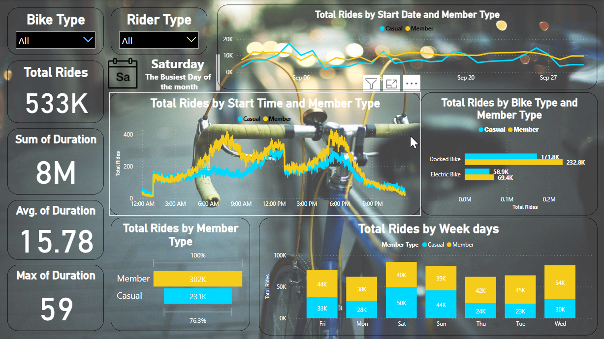
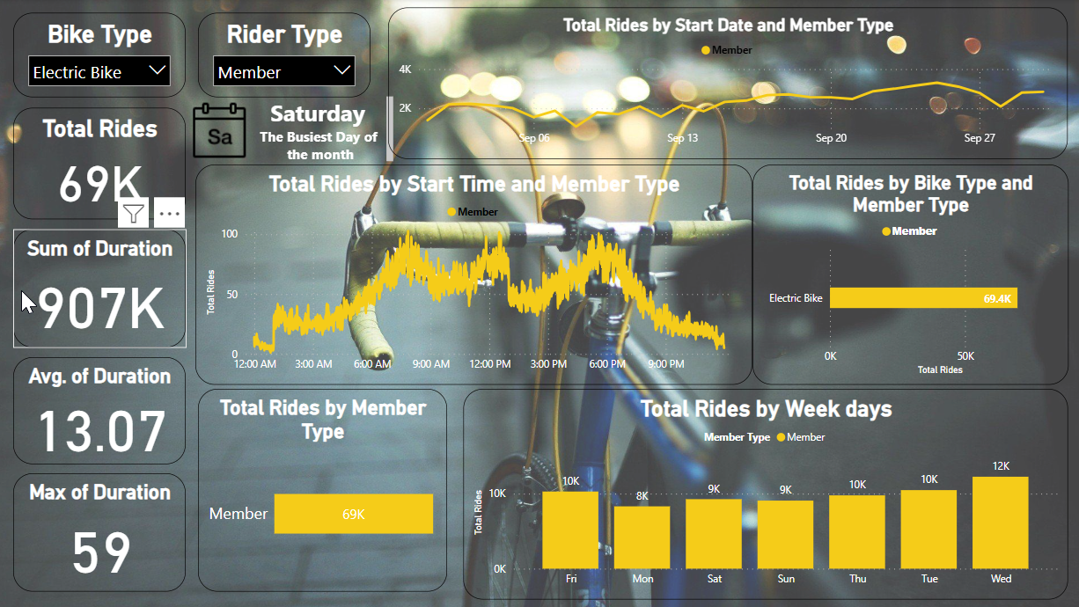
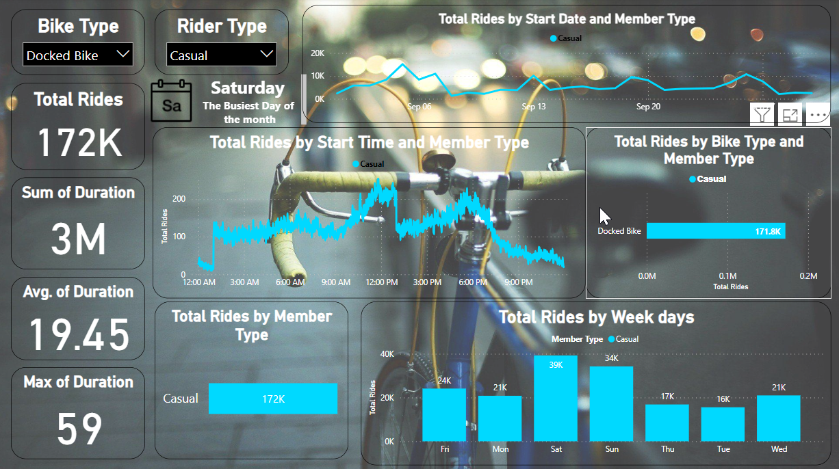
Visuals

Slide 10
THANK YOU
Mirjam Nilsson​
mirjam@contoso.com
www.contoso.com

